Slide 1


BIKE RENTAL OPERATION ANALYSIS
Presented By :
Saayan Samanta

Slide 2
Dataset Overview
Field Name | Description
instant | Unique record ID for each entry
dteday | Date of the rental record
season | Season category (1: Spring, 2: Summer, 3: Fall, 4: Winter)
yr | Year of record (0: 2011, 1: 2012)
mnth | Month number (1–12)
hr | Hour of the day (0–23)
holiday | Whether the day is a holiday or not
weekday | Day of the week
workingday | Indicates working day or weekend/holiday
weathersit | Weather condition category
temp | Normalized temperature
atemp | Feels-like temperature
hum | Humidity level
windspeed | Wind speed value
casual | Number of casual users
registered | Number of registered users
cnt | Total rentals (casual + registered)
Bike Rental Dataset contains hourly records of a bike-sharing system collected over different days, seasons, and weather conditions. The main purpose of the dataset is to analyze how factors such as time, weather, holidays, and seasons affect bike rental patterns.
The dataset is useful for identifying customer behavior, peak rental periods, and environmental conditions that influence bike usage. It helps businesses and city transportation systems make better operational and planning decisions.

Slide 3
Registered VS Casual Users
Registered users contribute most total rentals and display more consistent riding patterns compared to casual users. Generally, casual users are more active during weekends and holidays, suggesting that they primarily use the service for leisure and recreational purposes.
This difference in behavior helps the business understand customer segments more clearly and develop targeted marketing strategies.
Key Insight:
Registered users ensure stable revenue, while casual users create opportunities for seasonal and tourism-based growth.

Slide 4
Weekday VS Weekend
The analysis shows that bike rentals are generally higher on weekdays, mainly due to office commuting and regular travel activities. Users rely heavily on bike-sharing services during working days, especially during peak office hours.
On weekends, rental patterns shift toward leisure and recreational usage. Casual riders become more active, while overall demand remains relatively stable.
Key Insight:
Businesses can allocate more bikes and improve station availability during busy weekdays while introducing promotional offers and tourism-focused campaigns during weekends to attract casual riders.

Slide 5
Demand Trend
Rental demand reaches its highest levels during morning and evening office commuting hours. Most users prefer bikes as a convenient and cost-effective mode of transportation during daily work routines.
The data also indicates lower activity during midnight and early morning hours, which helps identify low-demand periods for maintenance and operational optimization.
Key Insight:
Office commuting hours are the primary drivers of daily rental demand.

Slide 6
Weather Impact on Rentals
Weather has a strong positive relationship with bike rental demand. Moderate temperatures encourage more users to rent bikes, while extreme heat, heavy rainfall, humidity, and high wind speed negatively impact rentals.
Weather conditions can therefore be used as an important forecasting factor to predict demand fluctuations and improve operational planning.
Key Insight:
Weather-based forecasting can significantly improve service efficiency and customer satisfaction.

Slide 7
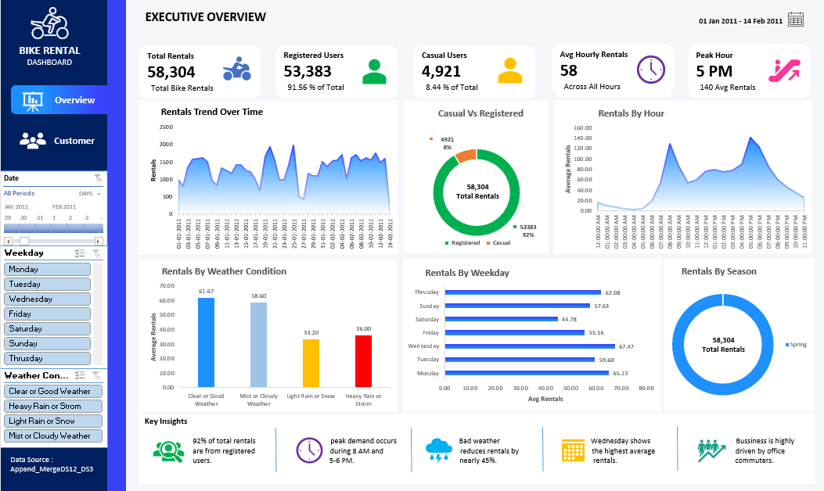
Executive Overview Dashboard
This dashboard provides a high-level overview of bike rental performance, customer demand patterns, weather impact, and operational trends. It helps stakeholders quickly monitor key business metrics and make data-driven decisions.

Slide 8
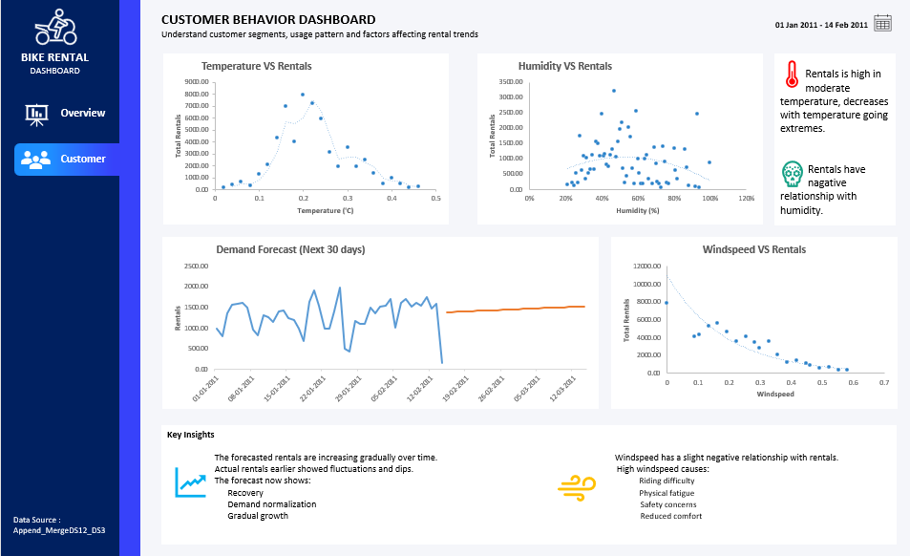
Consumer Behavior Dashboard
This dashboard analyzes customer rental behavior and the impact of environmental factors on bike rental demand. It highlights the relationship between rentals and variables such as temperature, humidity, and wind speed, along with a 30-day demand forecast.

Slide 9
Overall Analytical Findings
The bike rental business demonstrates strong growth potential driven by urban mobility trends and environmentally friendly transportation preferences. By understanding customer behavior, weather influence, and seasonal demand patterns, the company can make smarter operational and strategic decisions.
Data analytics plays a critical role in improving efficiency, maximizing revenue, and delivering a better customer experience, ultimately supporting long-term business success.

Slide 10


